Slide 1
Google Meet
Instructions

Slide 2
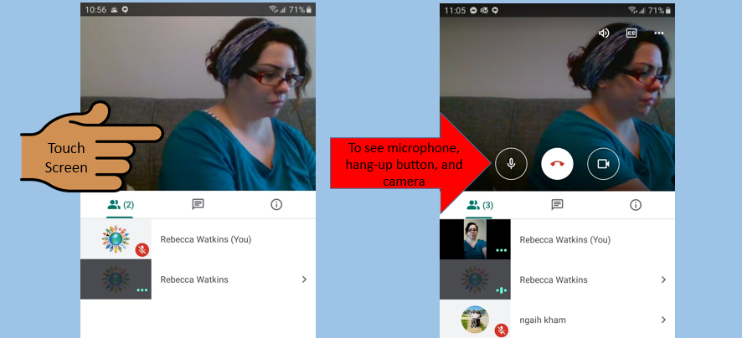
Touch your phone screen or move your cursor to the screen on your computer to see the controls

Slide 3
Mute your microphone.

Slide 4
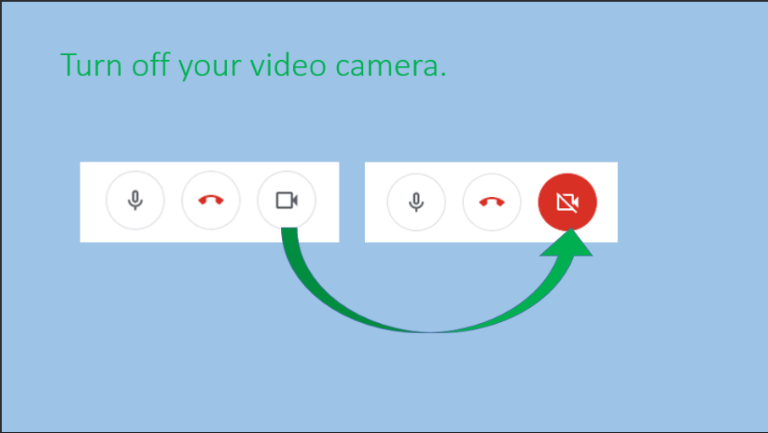

Slide 5
Do not click unless you have to leave.
If you do, click the join link again to come back.

Slide 6
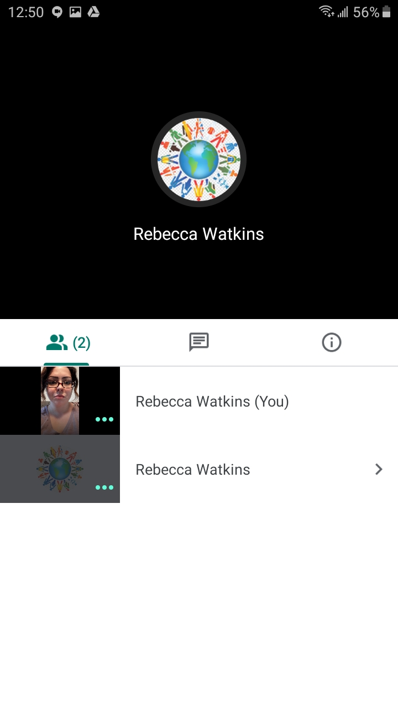
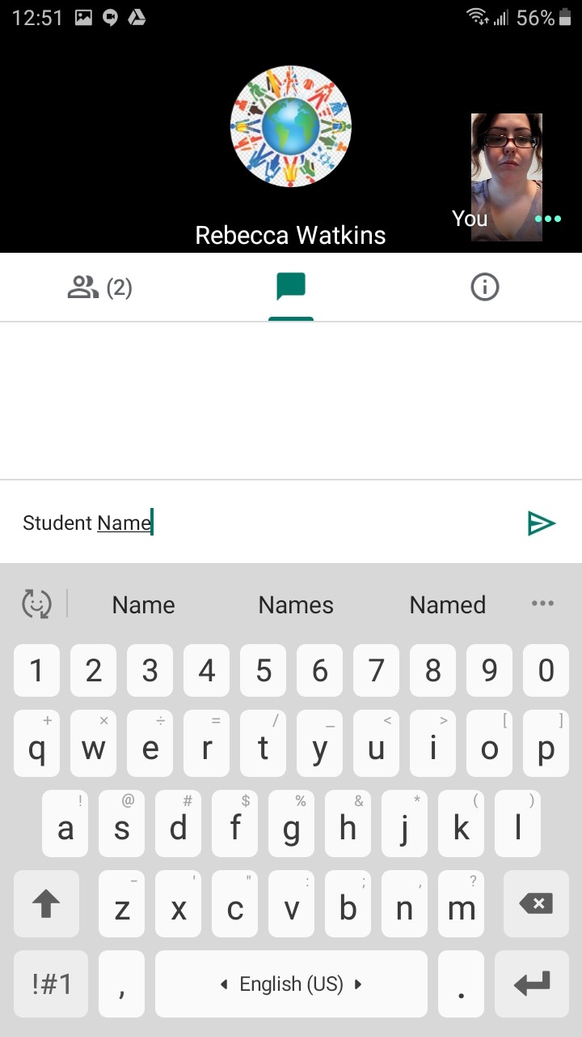
Phone: Type your name in the chat.
CLICK HERE
TYPE YOUR NAME HERE
CLICK HERE
TO SEND

Slide 7
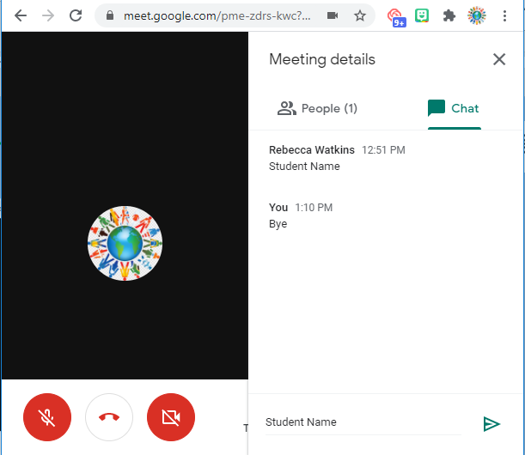
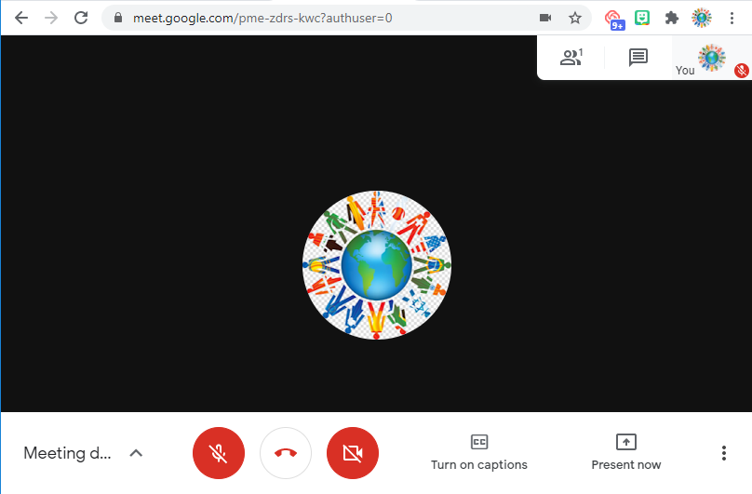
Computer: Type your name in the chat.
CLICK HERE
TYPE YOUR NAME HERE
CLICK HERE
TO SEND

Slide 8
Turn your phone to the side to see a larger screen.

Slide 9
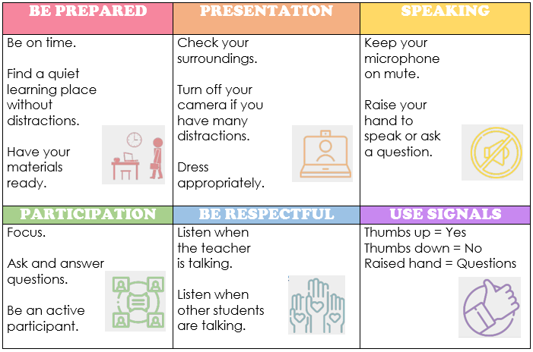
Google Meet Etiquette

Slide 10
If you have to leave early:
CLICK HERE TO LEAVE THE MEETING
TYPE “BYE” IN THE CHAT
CLICK SEND

